Slide 1
Description of Greece
By David Zupančič

Slide 2
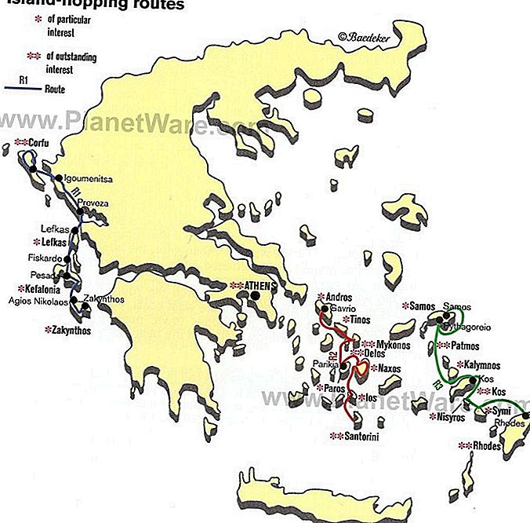
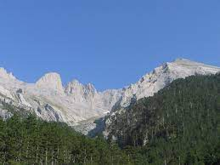
The landscape
Position
Bordering countrs
People (10⁷ ⁺ 780.000)
Nationality
Coastline (13.670 km)
Olympus (+53 m)

Slide 3
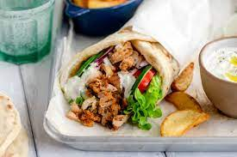

Typical dishes and flag
Flag
Riddle
Typical dishes

Slide 4
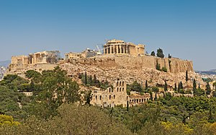
Sights
Capital city
Sights

Slide 5
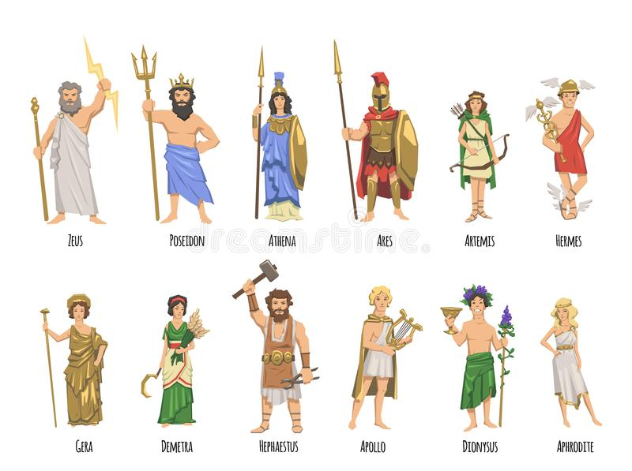
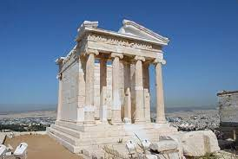
Mythology
Mythology
Temple
Riddle

Slide 6
Thank you for your attention!

